Slide 1
Concepts of Boolean Algebra

Slide 2
Tutorial
Lecture delivered by:
Deepak V.

Slide 3
Objectives
At the end of this lecture, student will be able to:
Acquire the knowledge Boolean Analysis of Logic Circuits
Draw a Logic Circuit

Slide 4
Topics
Simplification Using Boolean Algebra
Constructing a Logic Circuit

Slide 5
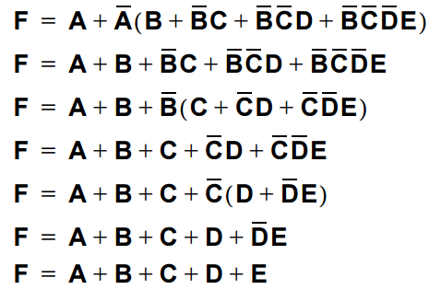
Simplification Using Boolean Algebra
Example: Simplify the following expression

Slide 6
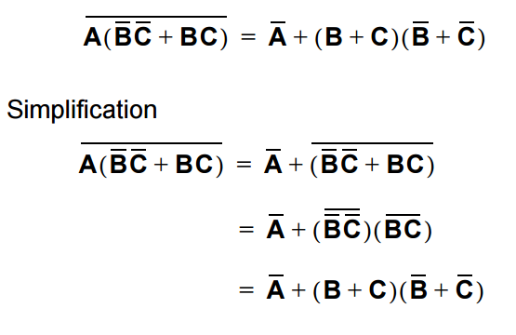
Simplification Using Boolean Algebra
Show that the following equality holds

Slide 7
Example
Example: How can we build a circuit that computes the function xy + (-x)y ?
x
xy
y
xy + (-x)y
x
-x
(-x)y
y

Slide 8
Summary
A simplified Boolean expression uses the fewest gates possible to implement a given expression
The logic circuit can be minimised by using simplification methods

